Slide 1
Deep Learning Frameworks
February 11, 2020
Jesse Spencer-Smith, Chief Data Scientist Data Science Institute Vanderbilt University

Slide 2
AI
Machine Learning
Expert Systems
Gradient Boosting
Deep Learning
Convolutional Neural Networks
General Problem Solver
Random Forest
Neural Nets
Recurrent Neural Networks
Logistic Regression
Transformers
Perceptron
1950 1960 1970 1980 1990 2000 2010 2020
Notes:
Story Intro
AI overview
Capabilities
What enables deep learning?

Slide 3
Bears
path = Path(data/bears)
classes = [teddys,grizzly,black]
data = ImageDataBunch.from_folder(path,
train=".", valid_pct=0.2,
ds_tfms=get_transforms(),
size=224,
num_workers=4).normalize(imagenet_stats)
learn = create_cnn(data, models.resnet34, metrics=error_rate)
learn.fit_one_cycle(4)

Slide 4
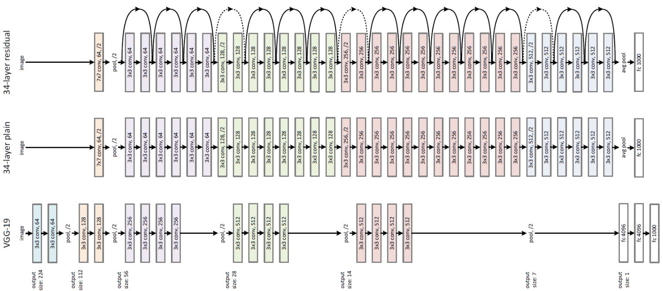

Slide 6
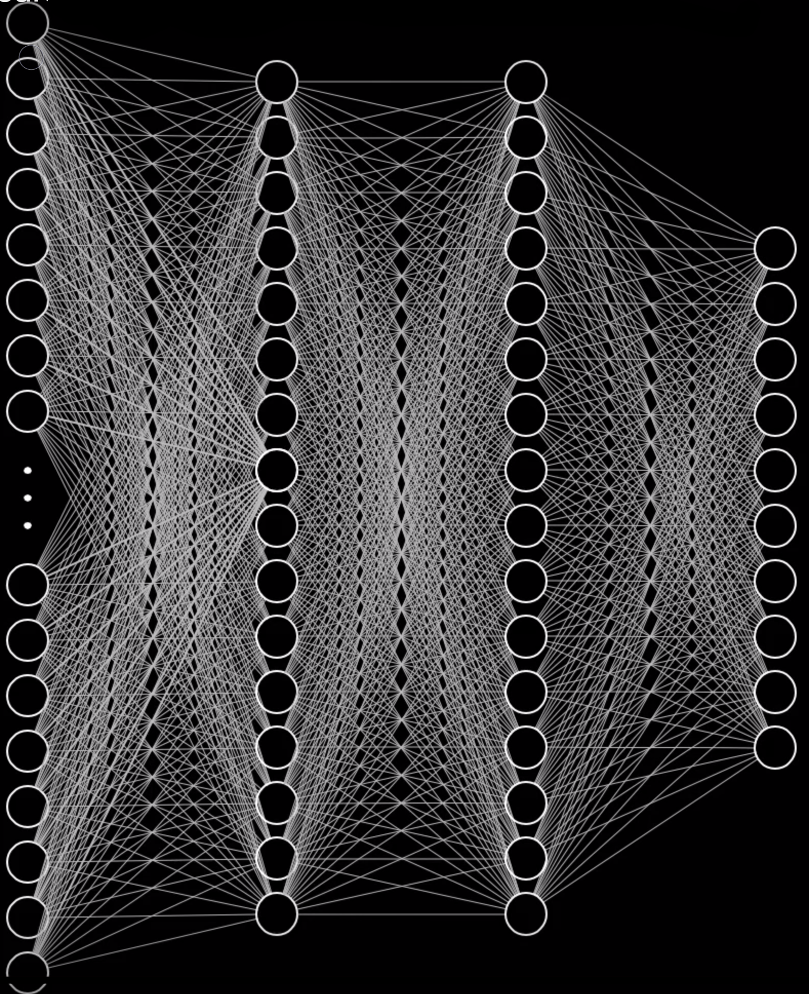
Notes:
What operations?
Inference matrix mult add
Training that + gradient, load many image, 1000’s, 1,000’s
Must do matrix multiplies and adds forward, and to gradient calculations backwards, many times. Batch. Load data quickly.
Hardware
GPU strengths
Limitations (memory)

Slide 7
CPU—Central Processing Unit
GPU—Graphics Processing Unit
6 cores
32GB RAM
Low Latency
Serial processing (parallel with work)
Several operations at once
4,352 CUDA cores
11GB RAM
High Throughput
Parallel processing by design
Thousands of operations at once
Tensor cores
Multiple cards
NVLink
Notes:
So, need to be able to quickly to matrix mult, add, forward
Quickly calc gradients back
What hardware do you need?
Hardware
GPU strengths
Limitations (memory)
Technical overview (single card, multiple cards, shared memory)
More cards, doesn't solve memory footprint
nvidia, nvlink
Why not do everything?
Limited opcodes
Limited memory
Very difficult to program
Need framework to handle backend

Slide 8
Deep Learning Frameworks
Provide
simplified access to power of GPUs
high-level API to express processing pipelines
representation of deep neural networks—graphs
simplified movement of data to and from GPU memory

Slide 9
PyTorch
Tensorflow
Pythonic
Integrates with rest of ecosystem
Growing adoption
Dynamic graph based
Speed can be slower (some differ)
Translate to C++
Dominant in research
Autodifferentiation
Python as calling language
Debugging requires active session
Widespread adoption
Dynamic graph as of TF 2.0 (eager execution)
Highly optimizable
Many paths to production
Dominant in production
Autodifferentiation

Slide 10
fast.ai Frameworks
Sits atop PyTorch
Provides sensible preset for common parameters
Provides high-level function

Slide 11
Bears Professors
path = Path(data/bears)
classes = [teddys, grizzly, black] data = ImageDataBunch.from_folder(path,
train=".", valid_pct=0.2,
ds_tfms=get_transforms(),
size=224,
num_workers=4).normalize(imagenet_stats)
learn = create_cnn(data, models.resnet34, metrics=error_rate)
learn.fit_one_cycle(4)
path = Path(data/professors)
classes = [archeology, arthistory, astronomy, chemistry, compsci, engineering, english, math, psychology, statistics]
data = ImageDataBunch.from_folder(path,
train=".", valid_pct=0.2,
ds_tfms=get_transforms(),
size=224,
num_workers=4).normalize(imagenet_stats)
learn = create_cnn(data, models.resnet34, metrics=error_rate)
learn.fit_one_cycle(4)

Slide 12

Pretrained Models
https://github.com/onnx/models
NLP
Huggingface

Slide 13
Extending PyTorch/TensorFlow
Differentiable programming

Slide 14
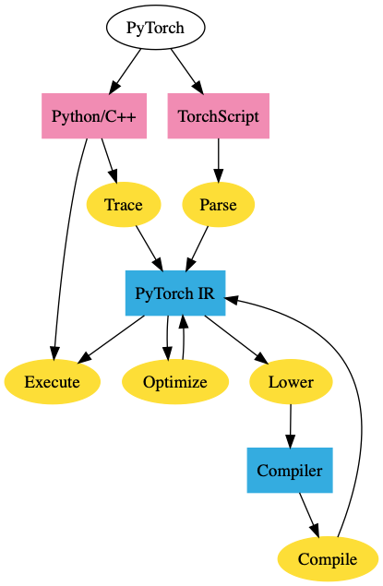

Slide 15
Training Models
Roll your own
Collab
Paperspace
ACCRE

Slide 16
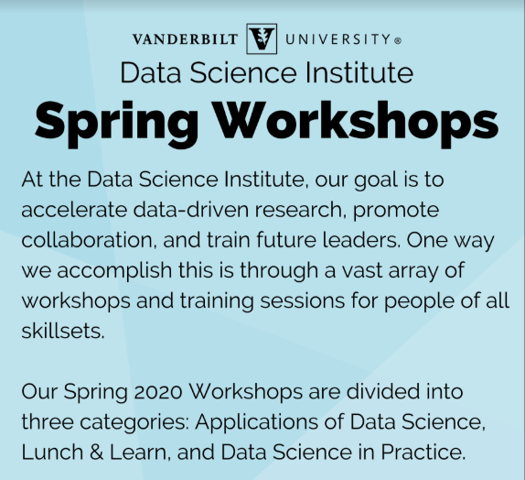
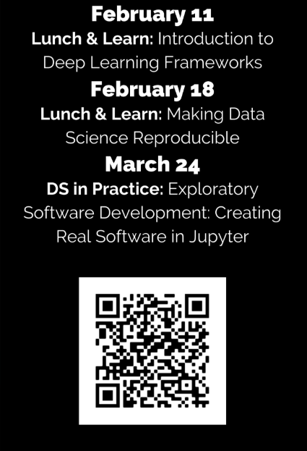
Visit https://www.vanderbilt.edu/datascience/events/data-science-workshops/

Slide 17
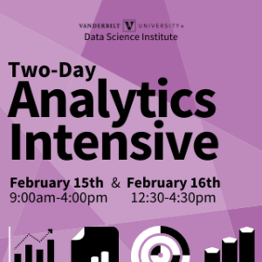
Visit https://www.vanderbilt.edu/datascience/events/data-science-workshops/

Slide 18
NLP Learning Cohort
A Code-First Introduction to Natural Language Processing fast.ai Rachel Thomas
Topics: topic modeling, classification, language modeling, and translation
Approaches:
traditional NLP (including regex, SVD, naive bayes, tokenization) and
neural network (including RNNs, seq2seq, attention, and the transformer architecture)
Email Jesse.Spencer-Smith@Vanderbilt to be added to the Slack organizing channel.

Slide 19
Visit https://www.vanderbilt.edu/datascience/events/data-science-workshops/

Slide 20

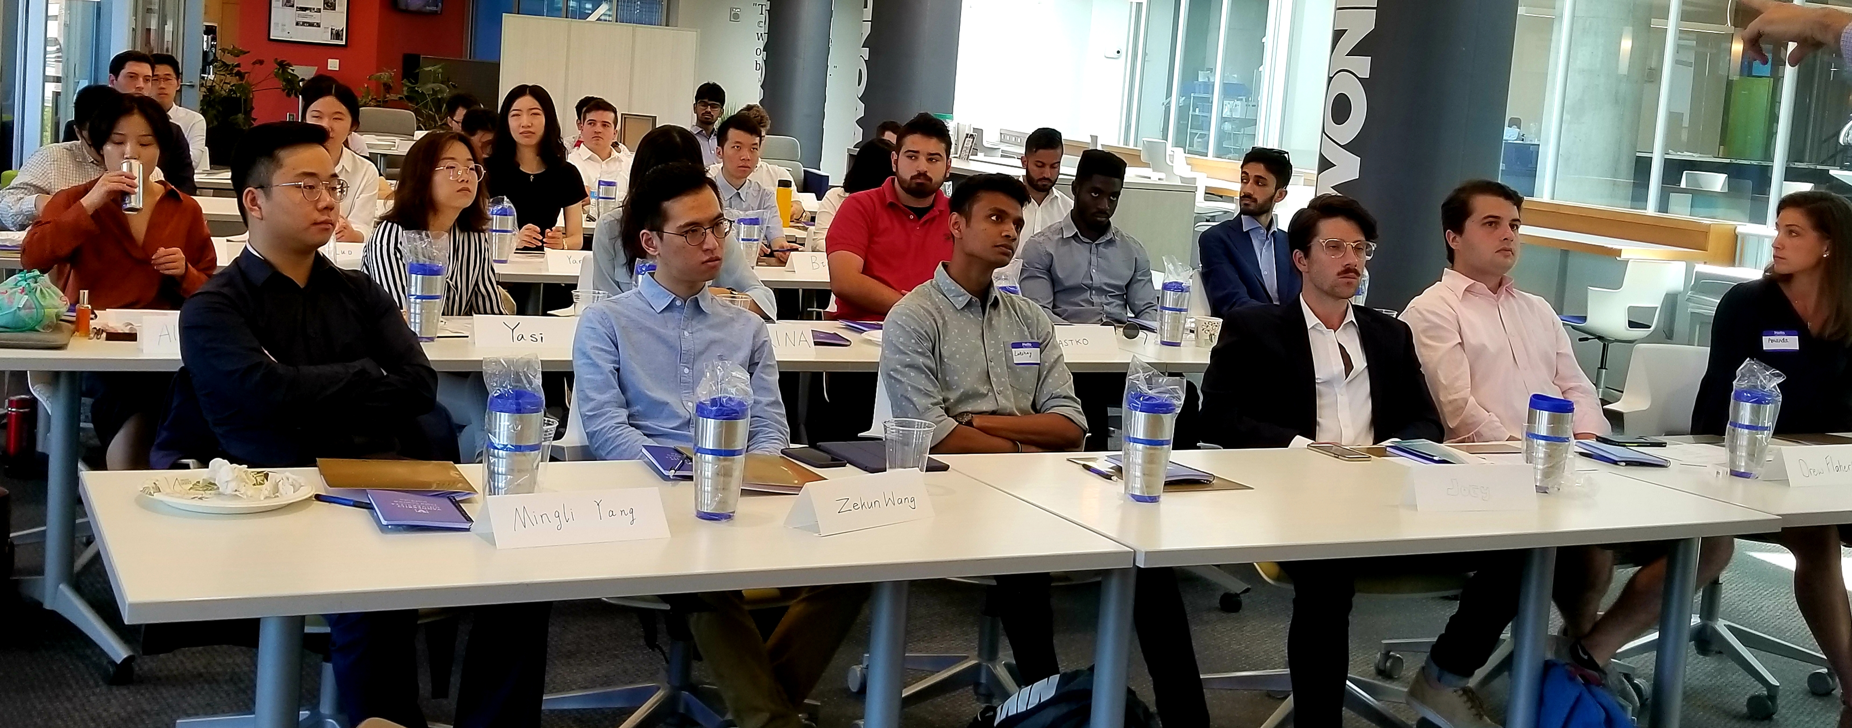
Professional M.S. Program
If you are interested in having summer interns or advising MS capstone projects, come talk to us!

Slide 21
www.vanderbilt.edu/datascience/

Slide 22

Slides, resources, and links at https://github.com/vanderbilt-data-science/dl-frameworks

Slide 23
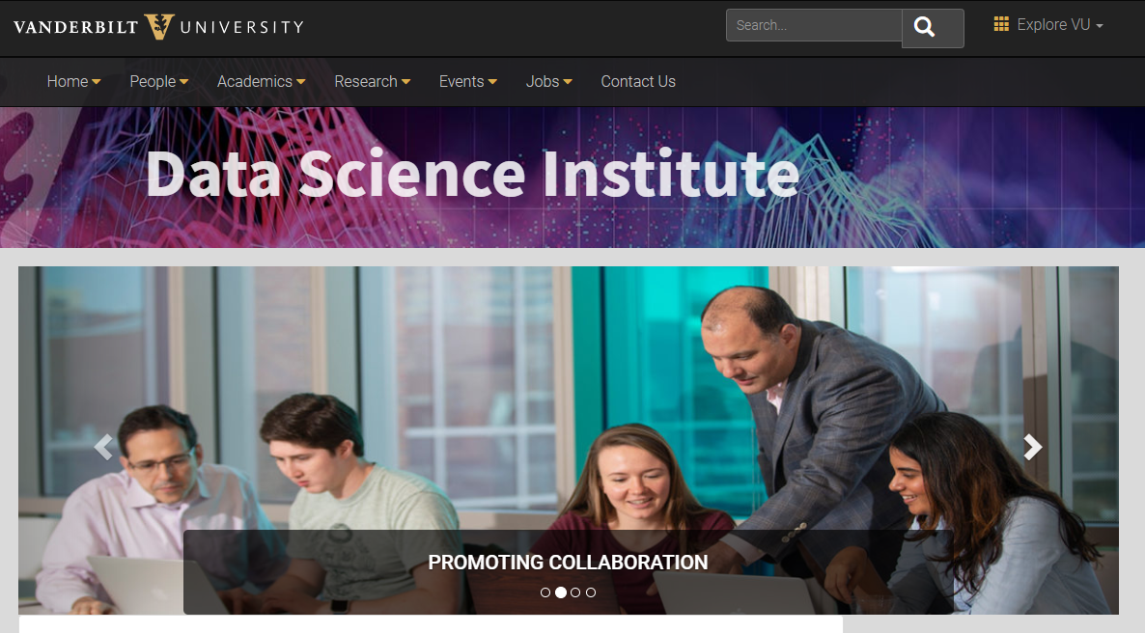

Slide 24
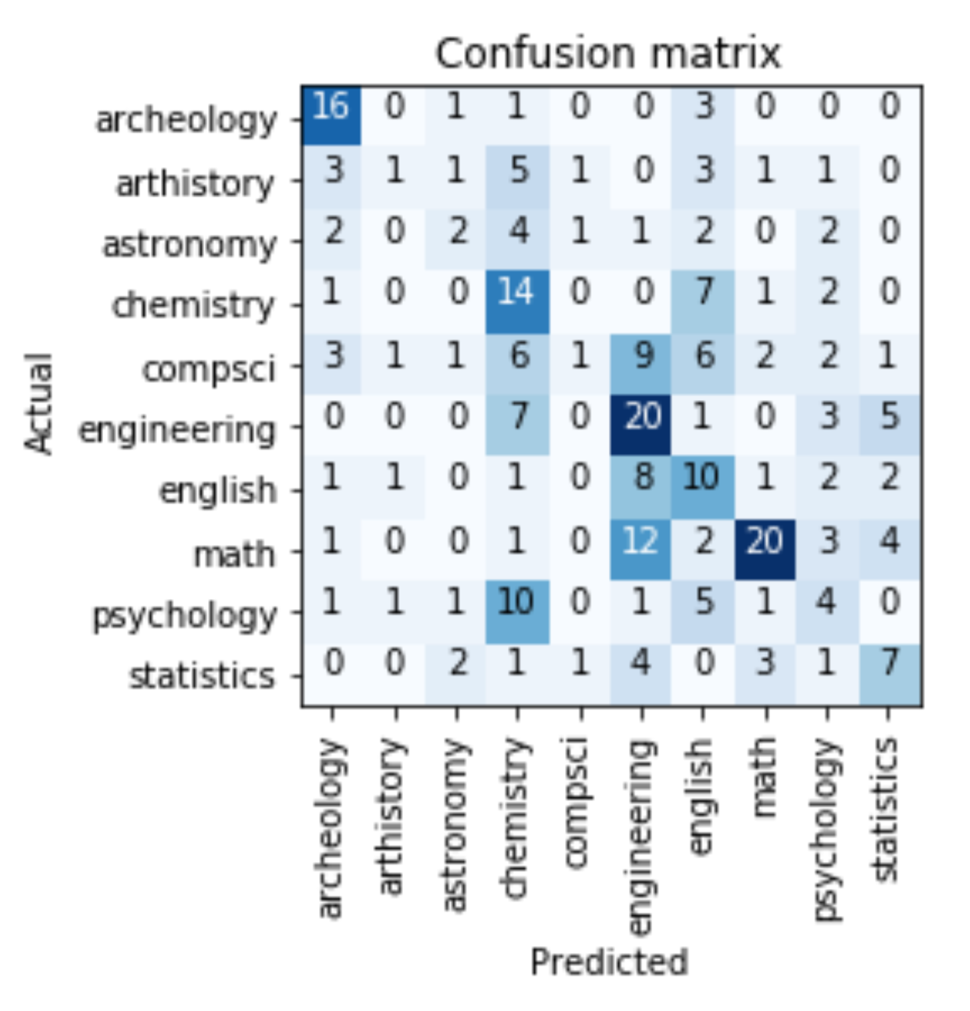
Guess the Area
Correct Answer →
✗
✓

Slide 25
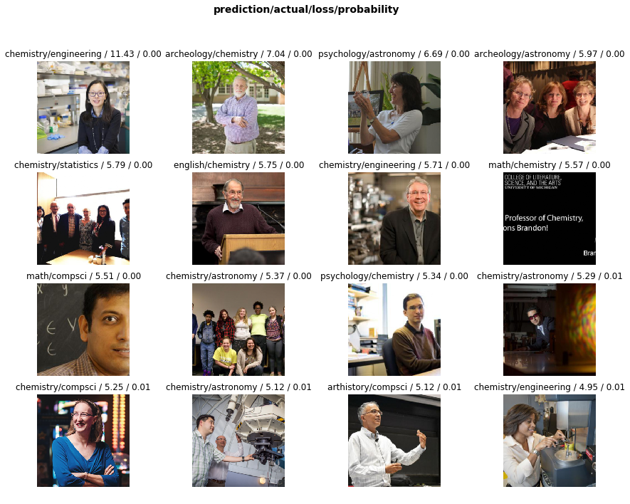
Guess the Area
Correct Answer →
✗
Archeology
Art history
Astronomy
Chemistry
Computer Science
Engineering
English
Informatics
Math
Psychology
Statistics
Model predicted →
✓

Slide 26
Guess the Area
Correct Answer →
✗
Archeology
Art history
Astronomy
Chemistry
Computer Science
Engineering
English
Informatics
Math
Psychology
Statistics
✓
Model predicted →

Slide 27
Guess the Area
Correct Answer →
✗
Archeology
Art history
Astronomy
Chemistry
Computer Science
Engineering
English
Informatics
Math
Psychology
Statistics
✓
Model predicted →

Slide 28
Guess the Area
Correct Answer →
Archeology
Art history
Astronomy
Chemistry
Computer Science
Engineering
English
Informatics
Math
Psychology
Statistics
Model predicted →
✗
✓

Slide 29
Guess the Area
Correct Answer →
✗
Archeology
Art history
Astronomy
Chemistry
Computer Science
Engineering
English
Informatics
Math
Psychology
Statistics
Model predicted →
✓

Slide 30
Professor or Grad Student?
Correct Answer →
Graduate student images: 55
Professor images: 43
Validation set: 17

Slide 32
Thank you!
Visit us at the Data Science Institute, Wond’ry Suite 300
Visit our website https://www.vanderbilt.edu/datascience/
Follow us on Twitter: @VUDataScience
Stop by Data Science Office Hours: Tuesdays, 9-11am (no office hours next week)
Interested in a Deep Learning Workshop (followed by fast.ai DL1 cohort)? E-mail jesse.spencer-smith@vanderbilt.edu

Slide 33
Bears Professors
path = Path(data/bears)
classes = [teddys, grizzly, black] data = ImageDataBunch.from_folder(path,
train=".", valid_pct=0.2,
ds_tfms=get_transforms(),
size=224,
num_workers=4).normalize(imagenet_stats)
learn = create_cnn(data, models.resnet34, metrics=error_rate)
learn.fit_one_cycle(4)
path = Path(data/professors)
classes = [archeology, arthistory, astronomy, chemistry, compsci, engineering, english, math, psychology, statistics]
data = ImageDataBunch.from_folder(path,
train=".", valid_pct=0.2,
ds_tfms=get_transforms(),
size=224,
num_workers=4).normalize(imagenet_stats)
learn = create_cnn(data, models.resnet34, metrics=error_rate)
learn.fit_one_cycle(4)

Slide 34
Bears Professors
path = Path(data/bears)
classes = [teddys, grizzly, black] data = ImageDataBunch.from_folder(path,
train=".", valid_pct=0.2,
ds_tfms=get_transforms(),
size=224,
num_workers=4).normalize(imagenet_stats)
learn = create_cnn(data, models.resnet34, metrics=error_rate)
learn.fit_one_cycle(4)
path = Path(data/professors)
classes = [archeology, arthistory, astronomy, chemistry, compsci, engineering, english, math, psychology, statistics]
data = ImageDataBunch.from_folder(path,
train=".", valid_pct=0.2,
ds_tfms=get_transforms(),
size=224,
num_workers=4).normalize(imagenet_stats)
learn = create_cnn(data, models.resnet34, metrics=error_rate)
learn.fit_one_cycle(4)

